Slide 1
Chapter 4: Threads NARZU TARANNUM(NAT)

Slide 2
Chapter 4: Threads
Overview
Multicore Programming
Multithreading Models
Thread Libraries
Threading Issues
Operating System Examples

Slide 3
Motivation
Most modern applications are multithreaded
Threads run within application
Multiple tasks with the application can be implemented by separate threads
Update display
Fetch data
Spell checking
Answer a network request
Process creation is heavy-weight while thread creation is light-weight
Can simplify code, increase efficiency
Kernels are generally multithreaded

Slide 4
Threads
A tread is a basic unit of CPU utilization
It comprise
Thread ID
Program counter
Register set
Stack
It shares with other threads belonging to the same process its code section, data section and other OS resources such as open files and signals.
A traditional / heavyweight has a single thread of control.
If a process has multiple threads of control, it can perform more than one task at a time.

Slide 5
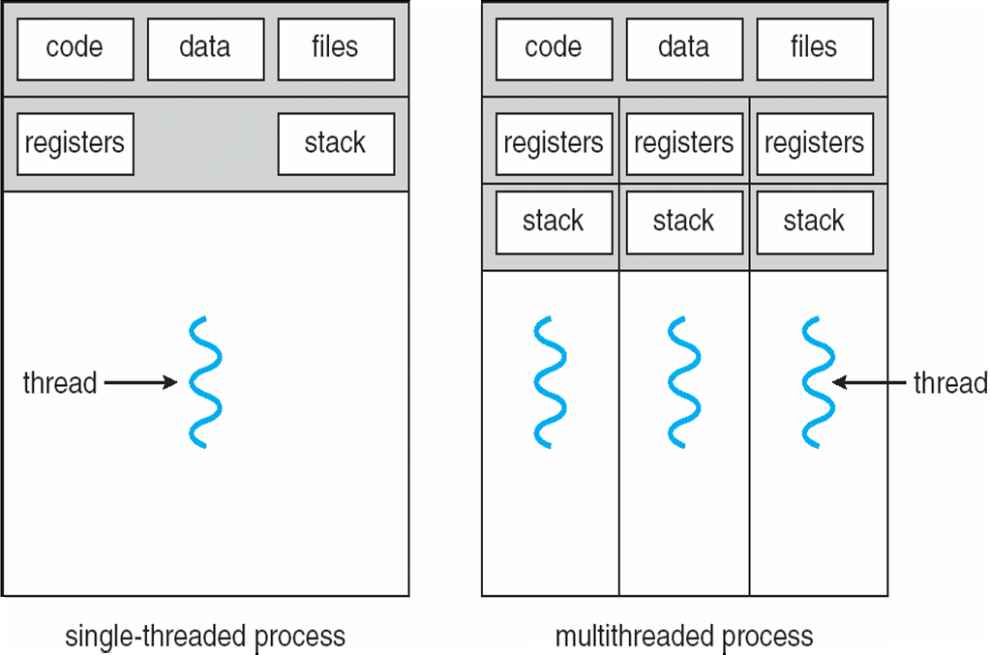
Single and Multithreaded Processes
Notes:
Multithreaded process are efficient and faster than single threaded process.

Slide 6
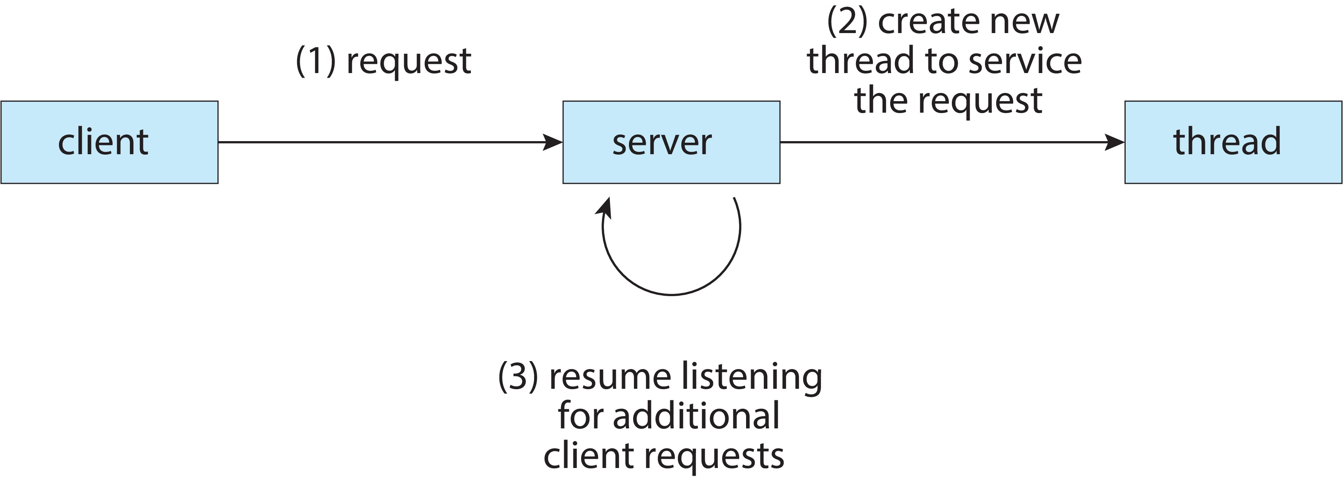

Multithreaded Server Architecture

Slide 7
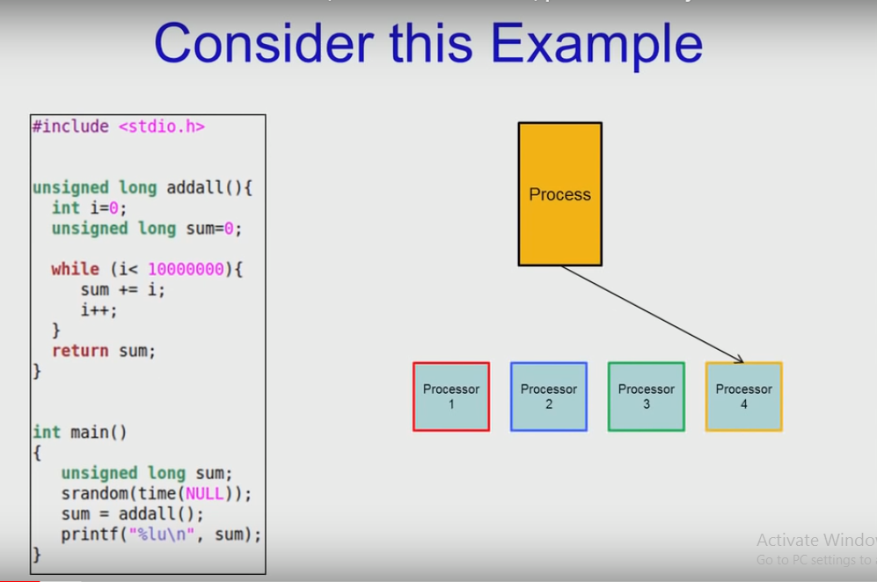

Slide 8
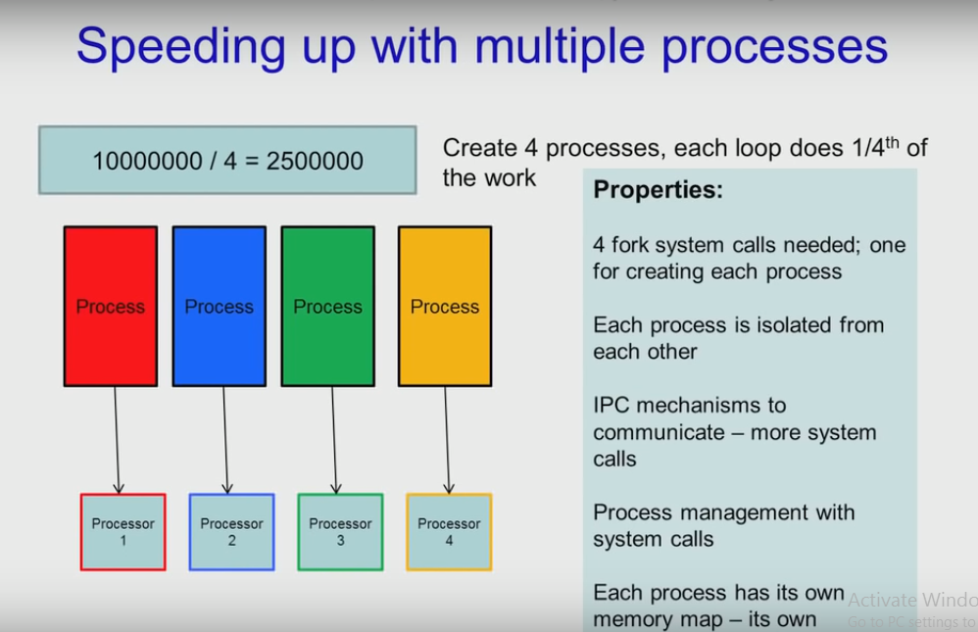

Slide 9
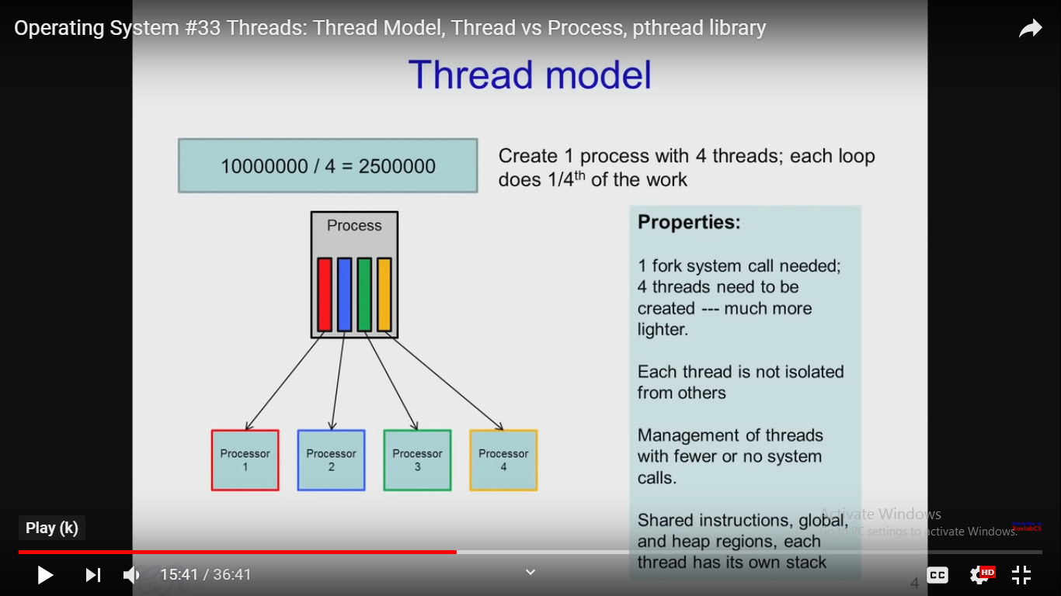

Slide 10
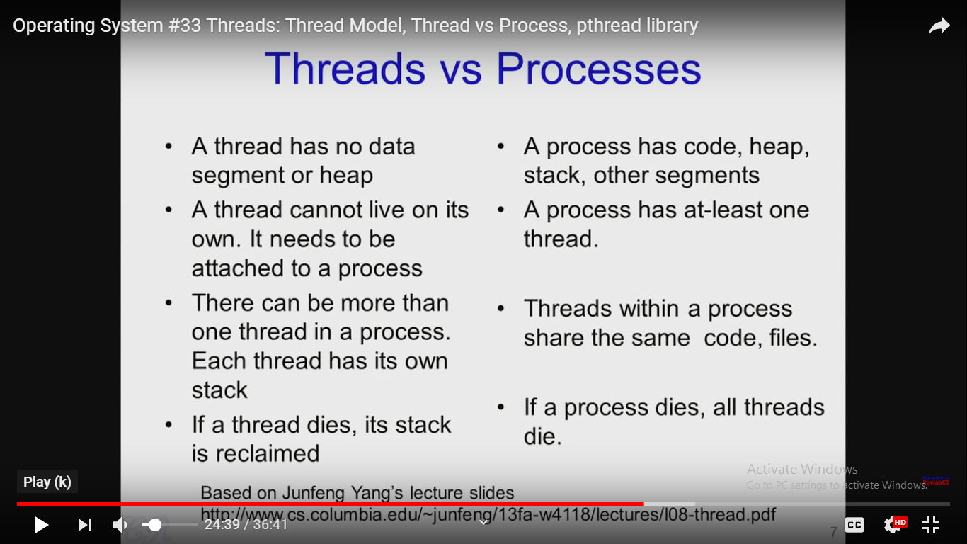

Slide 11
Benefits
Responsiveness – may allow continued execution if part of process is blocked, especially important for user interfaces
Resource Sharing – threads share resources of process, easier than shared memory or message passing
Economy – cheaper than process creation, thread switching lower overhead than context switching
Utilization of multiprocessor architecture– process can take advantage of multiprocessor architectures

Slide 12
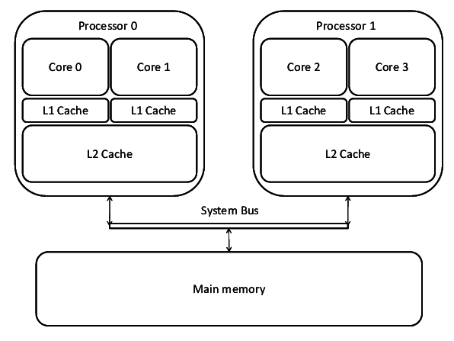
Multicore Programming
In most recent design whether the cores appear across CPU chips or within CPU chips, we call these systems multicore or multiprocessor systems.
Multithreaded programming provides a mechanism for more efficient use of these multiple computing cores and improve concurrency.

Slide 13
Multicore Programming
Multicore or multiprocessor systems putting pressure on programmers, challenges include:
Dividing activities
Balance
Data splitting
Data dependency
Testing and debugging

Slide 14
Concurrency vs. Parallelism
Concurrent execution on single-core system:
Parallelism on a multi-core system:
Parallelism implies a system can perform more than one task simultaneously
Running multiple threads/processes in parallel over different CPU cores
Concurrency supports more than one task making progress
Single processor / core, scheduler providing concurrency
Running multiple threads/processes at the same time, even on single CPU core, by interleaving their execution.

Slide 15
Multicore Programming (Cont.)
Two Types of parallelism
Data parallelism – data parallelism is achieved when each processor performs the same task on different pieces of distributed data.
Data parallelism is a form of parallel computing for multiple processors using a technique for distributing the data across different parallel processor nodes.
Synchronous computation is performed.
Task parallelism – distributing threads across cores, each thread performing unique operation
Task Parallelism means concurrent execution of the different task on multiple computing cores on the same or different data.
Asynchronous computation is performed.

Slide 16
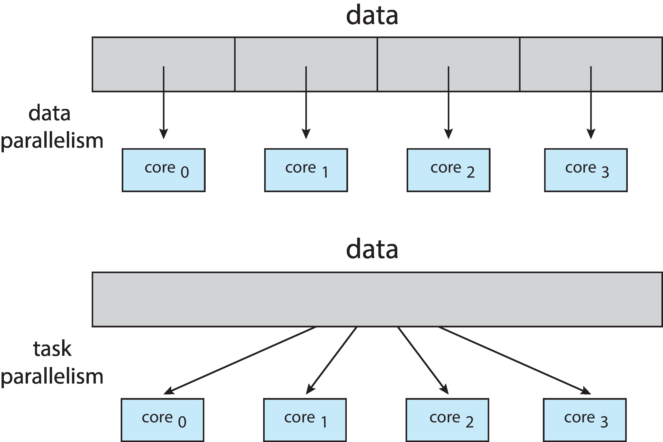
Data and Task Parallelism

Slide 17

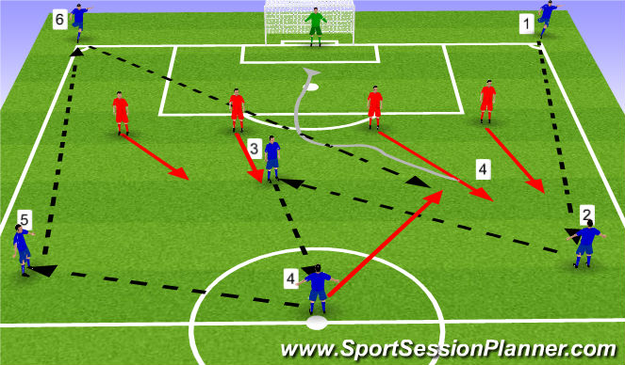

Data vs Task Parallelism
Data Parallelism
Single Instruction Multiple data
Multiple workers all doing same things
Task Parallelism
Multiple instruction same data or Multiple Instruction Multiple Data
Works with same objective

Slide 18
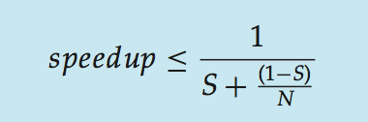
Amdahl’s Law
Identifies performance gains from adding additional cores to an application that has both serial and parallel components
Serial portion of an application has disproportionate effect on performance gained by adding additional cores
That is, if an application is 75% parallel and 25% serial with 2 cores, result speedup by 1.6 times

Slide 19
Amdahl’s Law
Amdahl’s Law is mainly used to predict the theoretical maximum speed-up for program processing using multiple-processors
It is a formula used to find the maximum improvement possible by just improving a particular part of a system
It is used in parallel computing to predict the theoretical speed-up when using multiple-processor

Slide 20
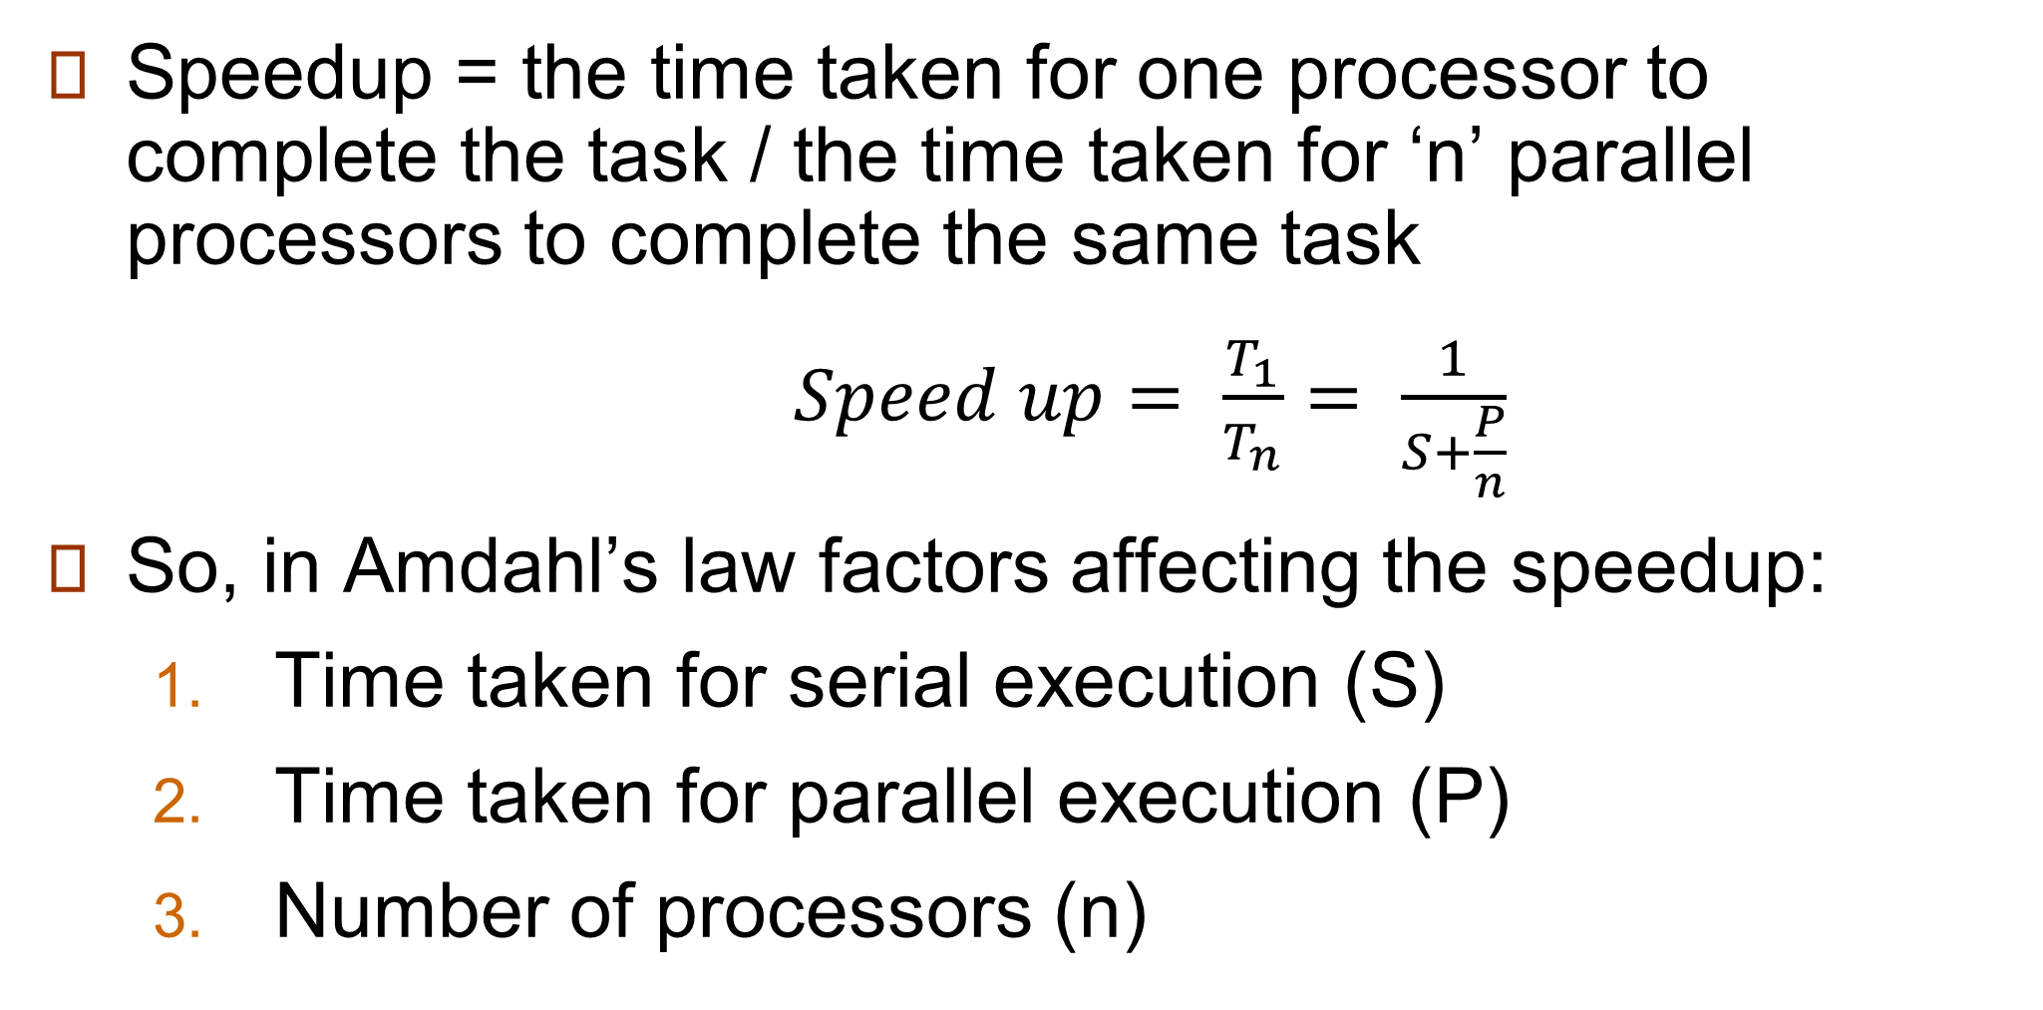
Amdahl’s Law
Speedup = the time taken for one processor to complete the task / the time taken for ‘n’ parallel processors to complete the same task
$Speed up= \frac{T_{1}}{T_{n}}= \frac{1}{S+\frac{P}{n}}$
So, in Amdahl’s law factors affecting the speedup:
Time taken for serial execution (S)
Time taken for parallel execution (P)
Number of processors (n)

Slide 21
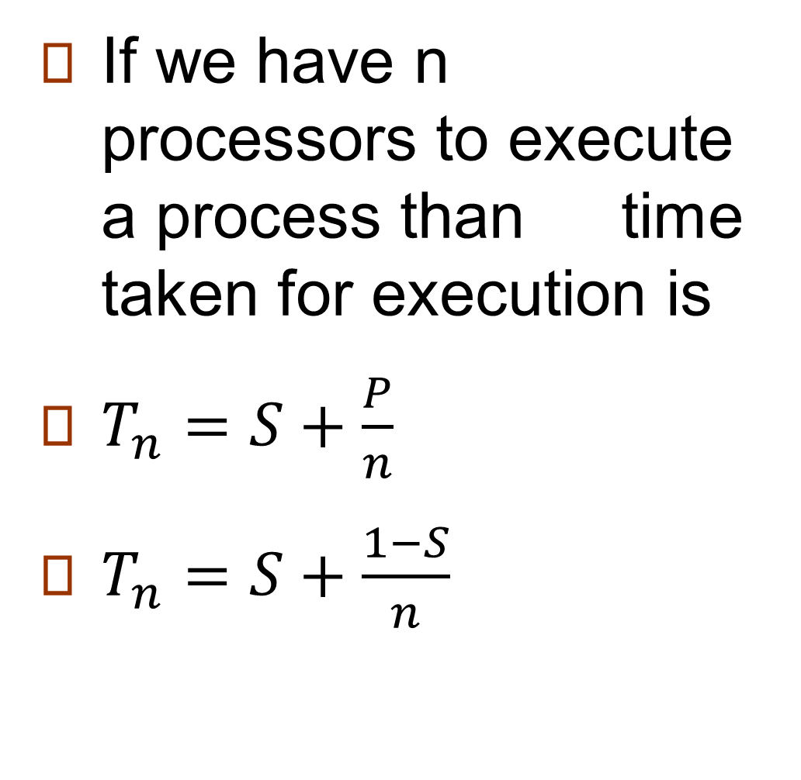
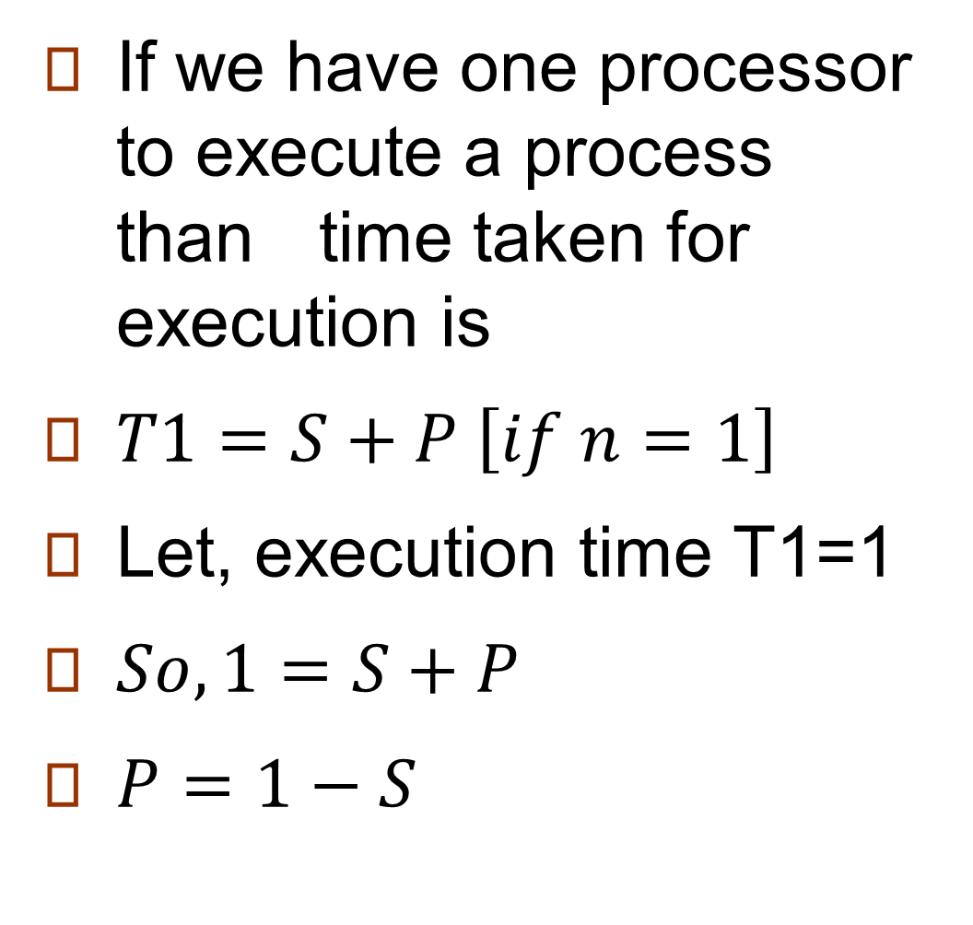
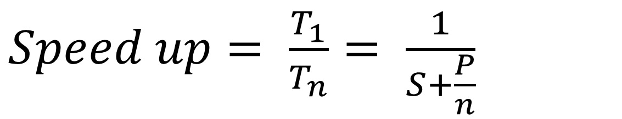
Amdahl’s Law
If we have one processor to execute a process than time taken for execution is
$T1=S+P \left[if n=1\right]$
Let, execution time T1=1
$So, 1=S+P$
$P=1−S$
If we have n processors to execute a process than time taken for execution is
$T_{n}=S+\frac{P}{n}$
$T_{n}=S+\frac{1−S}{n}$
$Speed up= \frac{T_{1}}{T_{n}}= \frac{1}{S+\frac{P}{n}}$

Slide 22
Types of Threads
User Threads
Thread management done by user-level threads library
User Threads are supported above the Kernel and are managed without kernel support.
Kernel knows nothing about User thread
Kernel Threads
Thread directed supported and managed by the OS
Many OS kernels are now multi-threaded; several threads operate in the kernel and each thread performs a specific task
For functioning both types of threads there must exists a relationship between them.

Slide 23
Multithreading Models
Many-to-One
One-to-One
Many-to-Many

Slide 24
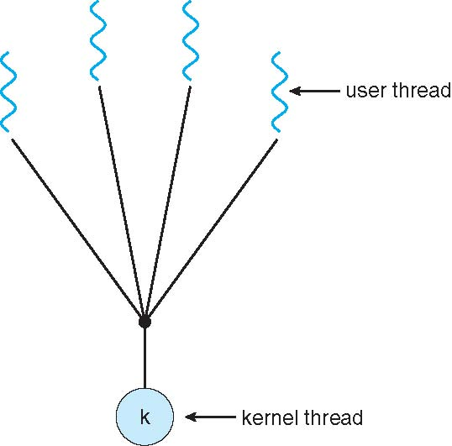
Many-to-One Model
Many user-level threads mapped to single kernel thread.
Thread management is done by the thread library in user space, so it is efficient.
If one thread makes a blocking system call causes the entire process block.
Because only one thread can access the kernel at a time, multiple threads are unable to run in parallel on multiprocessors.
Few systems currently use this model
Examples:
Solaris Green Threads
GNU Portable Threads

Slide 25
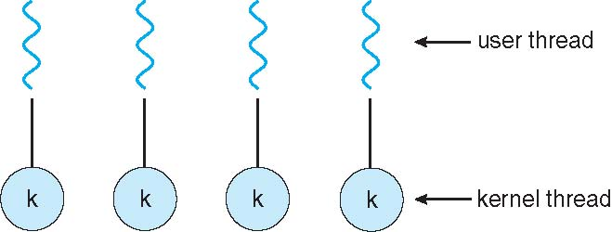
One-to-one Model
Each user-level thread maps to kernel thread
Creating a user-level thread creates a kernel thread
Provides more concurrency than the many to one model by allowing another thread to run when a thread makes a blocking system call
Also allows multiple-threads to run in parallel on multi-processors
Creating a user thread requires creating the corresponding kernel thread
Because the overhead of creating Kernel threads can Barden the performance of an application, most implementations of this model restrict the number of threads supported by the system.
Examples: Windows, Linux, Solaris 9 and later

Slide 26
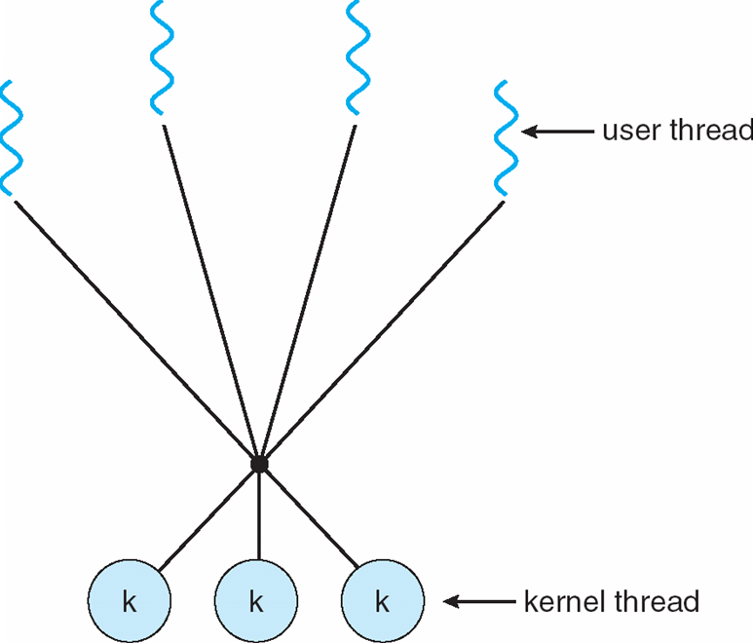
Many-to-Many Model
Multiplexes many user level threads to a smaller or equal number of kernel threads
Developers can creates as many user threads as necessary, and the corresponding kernel treads can run in parallel on a multi-processor
Also when a thread performs a blocking system call, the kernel can schedule another thread for execution
The number of kernel threads may be specific to either a particular application or a particular machine

Slide 27
Two-level Model
Similar to M:M, except that it allows a user thread to be bound to kernel thread
Examples
IRIX
HP-UX
Tru64 UNIX
Solaris 8 and earlier

Slide 28
Thread Libraries
Thread library provides programmer with API for creating and managing threads
Two primary ways of implementing a thread library
First approach is to implement a user level library with no kernel support. All code and data structures for the library (threads) exist in user space.
This means that invoking a function in a library results in a local function calling user space that is not a system call ( library entirely in user space) .
Second approach is to implement a kernel level library supported directly by the OS. In this case code and data structures for the library (threads) exist in kernel space (library supported by OS kernel level) .
This means that invoking a function in the library results in a system call to the kernel.
Three main thread libraries are in use today
POSIX Pthreads
Win32
JAVA

Slide 29
Thread Libraries
Pthreads
Pthreads, is the extension of the POSIX standard may be provided either as user-level or kernel-level library, which defining an API for thread creation and synchronization.
This is a specification for thread behavior not an implementation. It is up to developer or OS designer of the library.
Common in UNIX operating systems (Solaris, Linux, Mac OS X)
Win32
Win32 is a kernel level library available in windows system
These threads are created in the Win32 API using the Create Thread()
Just as Pthreads, a set of attributes or parameters is passed to this function

Slide 30
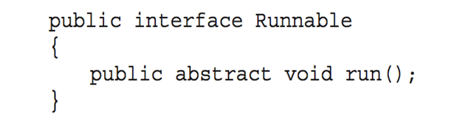
Thread Libraries
Java Threads
Java threads API (library) allow JAVA programs directly to creates and manage the threads
Typically implemented using the threads model provided by underlying OS.
Java threads are managed by the JVM
Even in single JAVA program which contains only a main() method runs as a single thread as the JVM
There are two techniques for crating threads in JAVA program
One approach is to create a new class that is derived from the thread class and to override its run() method
An alternative and more commonly used technique is to define a class that implements the Runnable interface. The runnable interface is defined as follows:

Slide 31
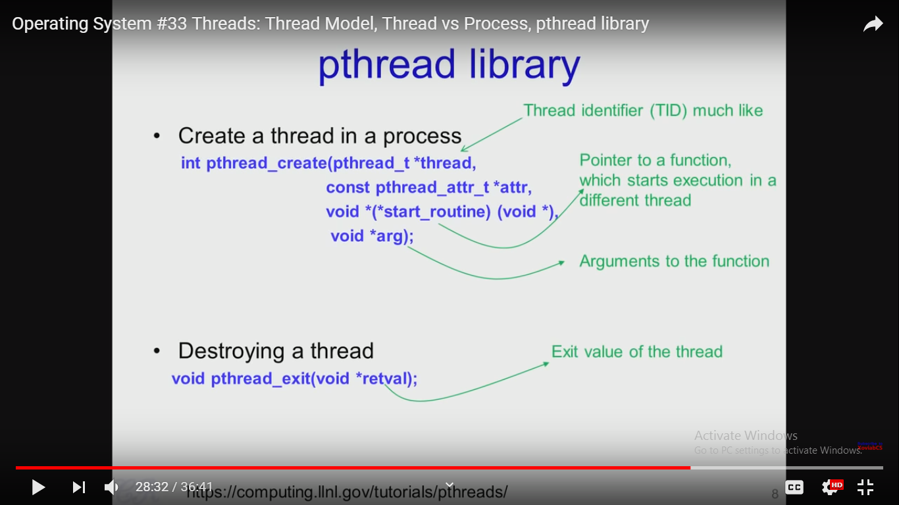
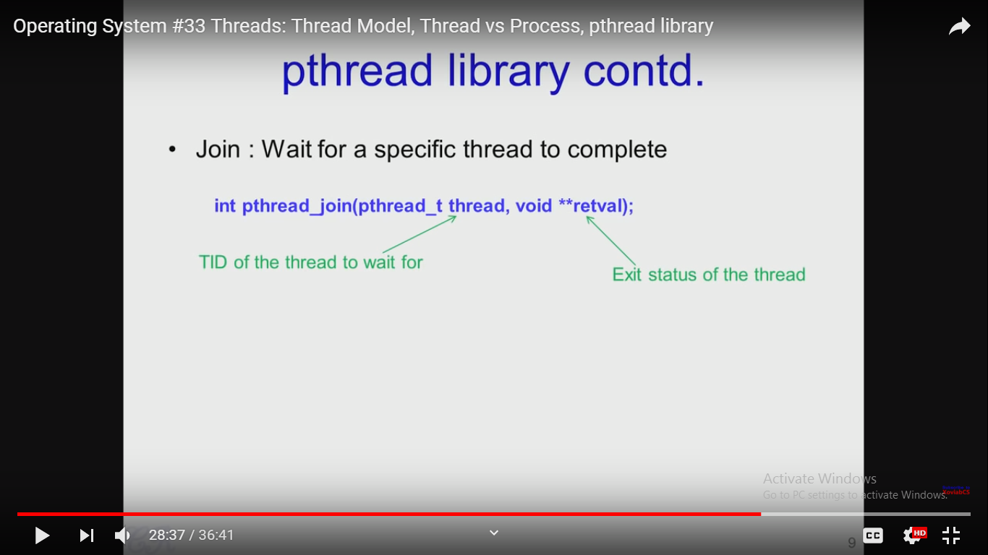

Slide 32
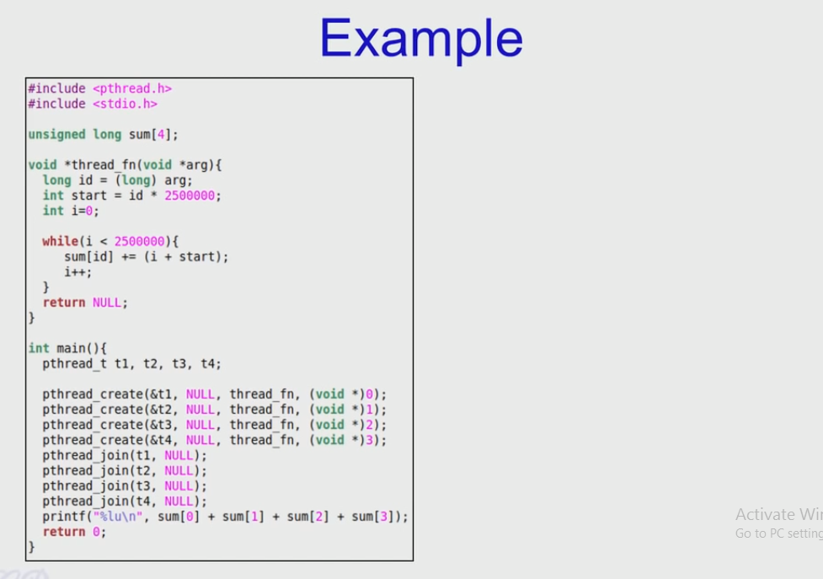

Slide 33
Implicit Threading
Implicit multi-threading is concurrent execution of multiple threads extracted from single sequential program.
Growing in popularity as numbers of threads increase, program correctness more difficult with explicit threads
Creation and management of threads done by compilers and run-time libraries rather than programmers

Slide 34
Implicit Threading
Three methods explored:
Thread Pools
OpenMP
Grand Central Dispatch

Slide 35
Thread Pools
If a web server receives a request, it creates a separate tread to serve the request. The issue arise:
Thread creation time
No bound on concurrent execution of threads
Thread pools:
Create a number of threads in a pool where they await for work
Advantages:
Usually slightly faster to service a request with an existing thread than create a new thread
Allows the number of threads in the application(s) to be bound to the size of the pool

Slide 36
Threading Issues
The fork() and exec() system calls
Thread Cancellation
Signal handling
Thread –Local Storage

Slide 37
The fork() and exec() system calls
fork()
The fork() system call is used to create a separate, duplicate process
exec()
When a exec() system call is invoked, the program specified in the parameter to exec() will replace the entire process –including all threads
Issue: If one thread in a program calls fork(), does the new process duplicate all threads or the new process single-threaded?
Solution: Some UNIX systems have chosen to have two versions of fork(), one that duplicates all threads and another that duplicates only the thread that invoked the fork() system call
But which version of fork() to use and when?

Slide 38
Which version of fork() will to be used depends on the application.
If exec() is called immediately after forking then duplicating all threads is unnecessary.
If the separate process does not call exec() after forking, the separate process should duplicate all threads

Slide 39
Thread Cancellation
Thread cancellation is the task of Terminating a thread before it has completed.
Thread to be canceled is target thread
Two general approaches:
Asynchronous cancellation: one thread terminates the target thread immediately.
There is an issue if a thread is cancelled while in the midst of updating data it is sharing with other threads.
Deferred cancellation allows the target thread to periodically check if it should be cancelled
Cancellation occurs only after the target thread has checked a flag to determine if it should be cancelled or not. So it should be canceled at a point when it can be cancelled safely.

Slide 40
Signal handling
Signals are used in UNIX systems to notify a process that a particular event has occurred.
Synchronous and asynchronous received signal.
A signal handler is used to process signals
A signal is generated by the occurrence of a particular event
A generated signal is delivered to a process
Once delivered, the signal must be handled
Every Signal may be handled by one of two possible handlers:
A default signal handler
A user-defined signal handler

Slide 41
Signal handling
Signals are always delivered to a process but delivering signals is more complicated in multi-threaded program. In that case following options exist
Deliver the signal to the thread to which the signal applies (Synchronous cancellation)
Deliver the signal to every thread in the process (Asynchronous cancellation)
Deliver the signal to certain threads in the process
Assign a specific thread to receive all signals for the process

Slide 42
Thread Local Storage
Threads belonging to a process share the data of the process. In some circumstances, each thread might need its own copy of certain data.
Create Facility needed for data private to thread is called Thread-local storage (TLS) or thread-specific data
Useful when you do not have control over the thread creation process (i.e., when using a thread pool)

Slide 43
End of Chapter 4

